Slide 1








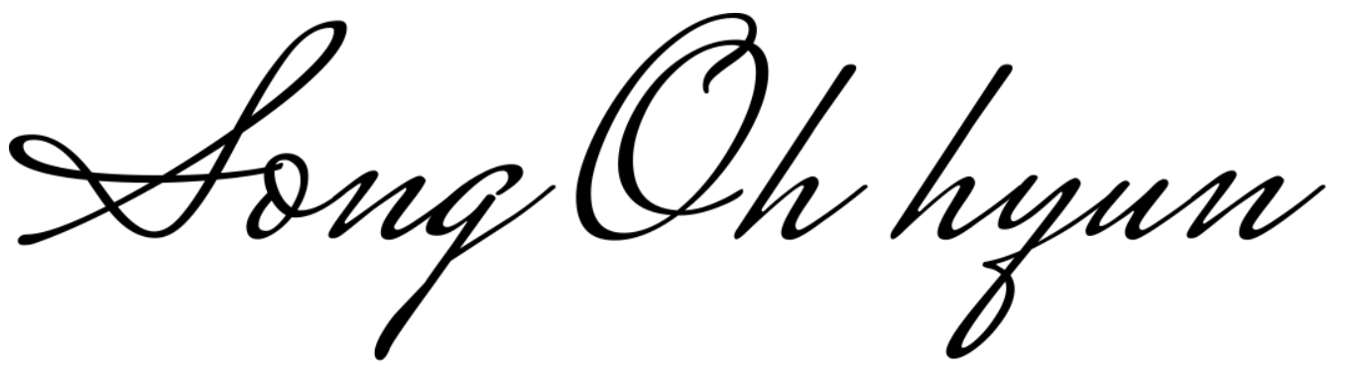
SPEECH CONTEST
WINNER
This certificate is awarded to
for winning
홍길동 (Gildong)
Third Place
Second Place
First Place
in Warren Teacher's
Theseus Class
Perseus Class
Odysseus Class
Hercules Class
Artemis Class
Hermes Class
Apollo Class
Zeus Class
E5 Athena Class
Helios Class
Poseidon Class
Gaia Class
Hera Class
E6 Song’s Class
Signature
31 May 1993
Date

